Slide 1
The Dot Product
Dr. Jacob Moore
Associate Professor of Mechanical Engineering
Penn State Mont Alto

Slide 2
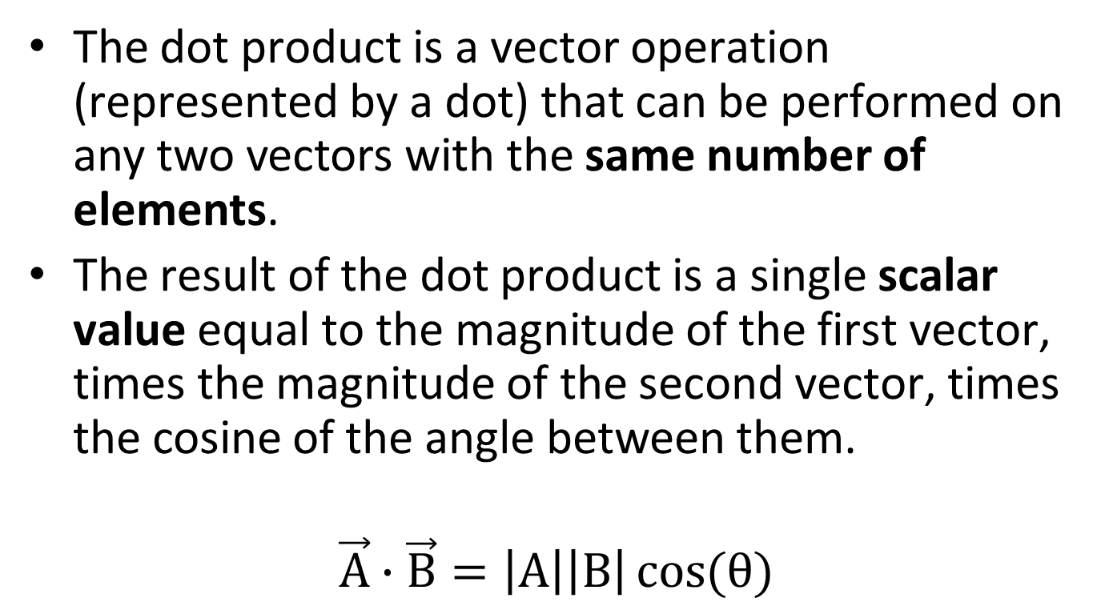
The Dot Product
The dot product is a vector operation (represented by a dot) that can be performed on any two vectors with the same number of elements.
The result of the dot product is a single scalar value equal to the magnitude of the first vector, times the magnitude of the second vector, times the cosine of the angle between them.
$$\vec{A}∙\vec{B}=\left|A\right|\left|B\right|\cos{(θ)}$$

Slide 3



The Dot Product
A
$$\vec{A}∙\hat{B}=\left|A\right|\left|B\right|\cos{(θ)}$$
if the magnitude of B is 1, then...
$$θ$$
$$C=\vec{A}∙\hat{B}=\left|A\right|\cos{(θ)}$$
C
B
If the second vector is a unit vector, then the dot product represents the component of the first vector in the direction of the unit vector. This is sometimes called the projection of the one vector in the direction of another.

Slide 4
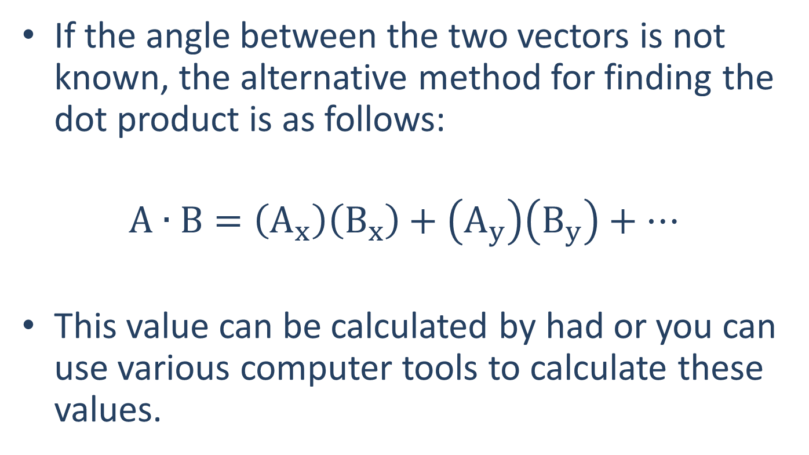
The Dot Product
If the angle between the two vectors is not known, the alternative method for finding the dot product is as follows:
$$A∙B=\left(A_{x}\right)\left(B_{x}\right)+\left(A_{y}\right)\left(B_{y}\right)+…$$
This value can be calculated by had or you can use various computer tools to calculate these values.

Slide 5
Thanks for Watching
See other engineering mechanics videos and access the full tool at…

Slide 6
Dot Product Worked Example
Find the dot product of force vector A with the unit vector shown with direction B.
y
x
F_{A}= 5 kN
B
30º

Slide 7



Dot Product Worked Example
Calculate the dot product of vector A with vector B by hand.
$$A= \left[1, 3, 5\right]$$
$$B= \left[6, 4, 2\right]$$
$$A ∙ B= ?$$

Slide 8
Dot Product Worked Example
Calculate the dot product of vector A with vector B using MATLAB.
$$A= \left[1, 3, 5\right]$$
$$B= \left[6, 4, 2\right]$$
$$A ∙ B= ?$$

Slide 9
Dot Product Worked Example
Calculate the dot product of vector A with vector B using Wolfram Alpha.
$$A= \left[1, 3, 5\right]$$
$$B= \left[6, 4, 2\right]$$
$$A ∙ B= ?$$

